Slide 1
Degrees of accuracy
Estimation and rounding

Slide 2
how to use Oak lessons

Slide 3
I can appreciate what is meant by a suitable degree of accuracy.

Slide 4
A degree of accuracy shows how precise a number or measurement is.
E.g. to the nearest cm, nearest 10, 1 s.f., etc.

Slide 5

Degrees of accuracy
Understanding degrees of accuracy
Answers to an appropriate degree of accuracy

Slide 6
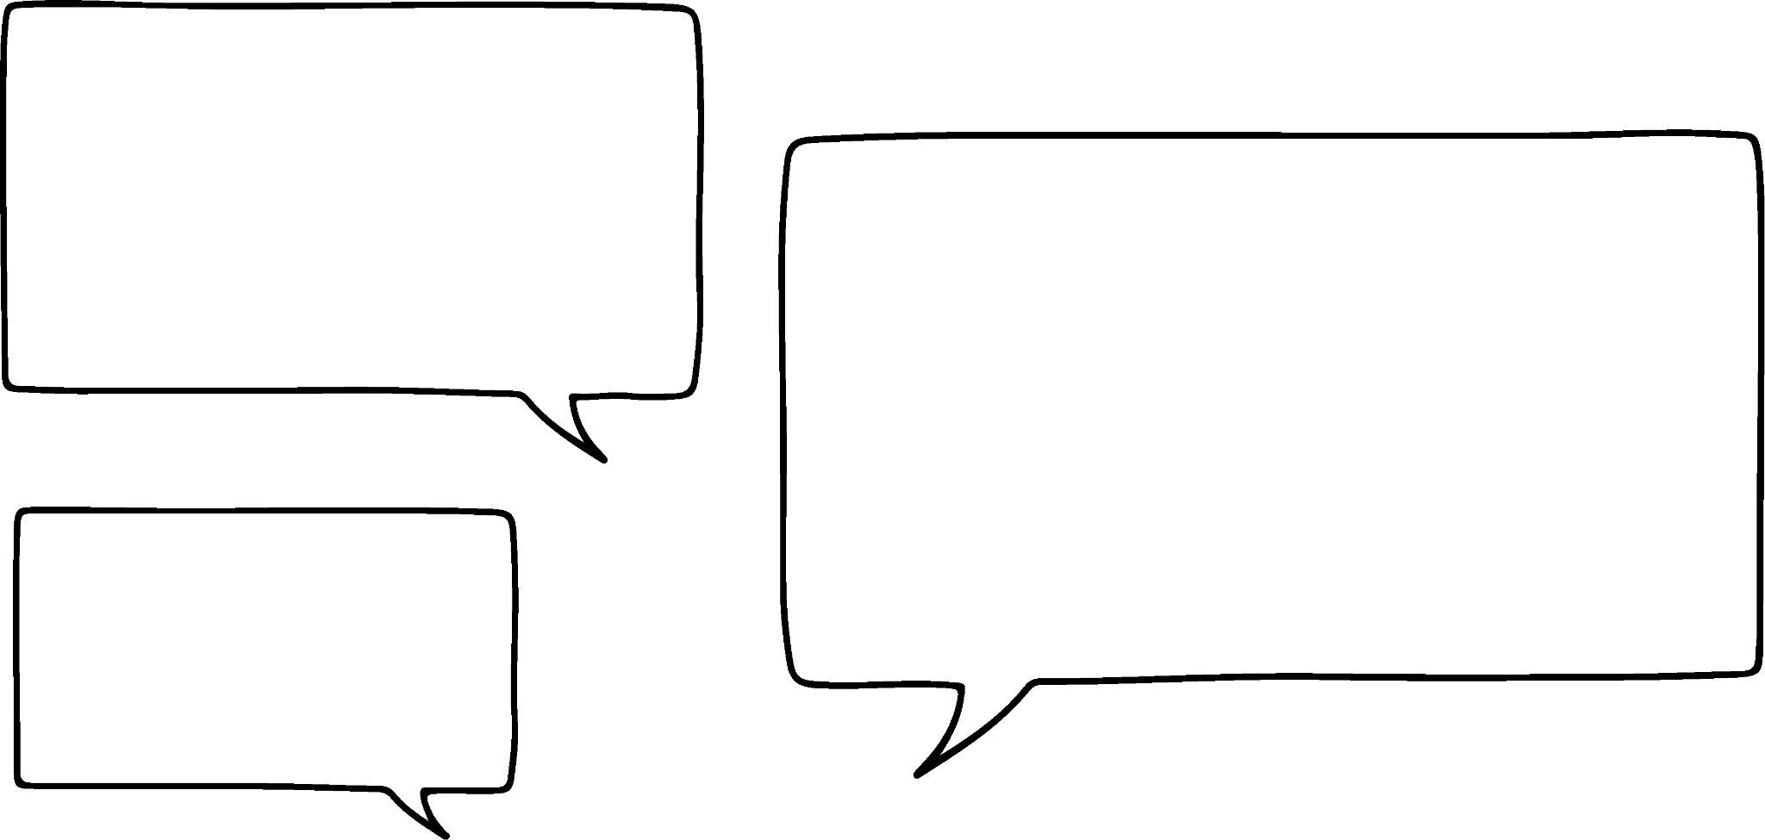

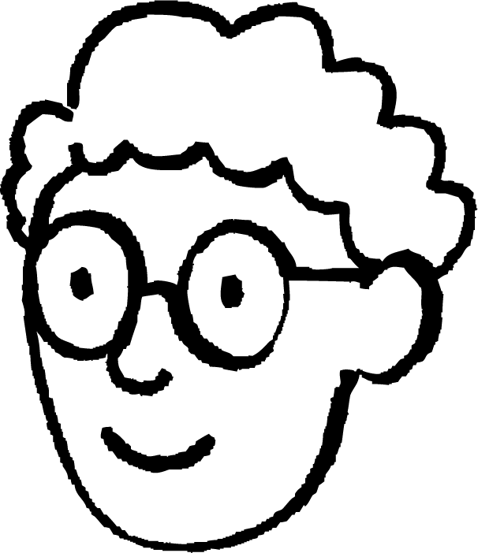
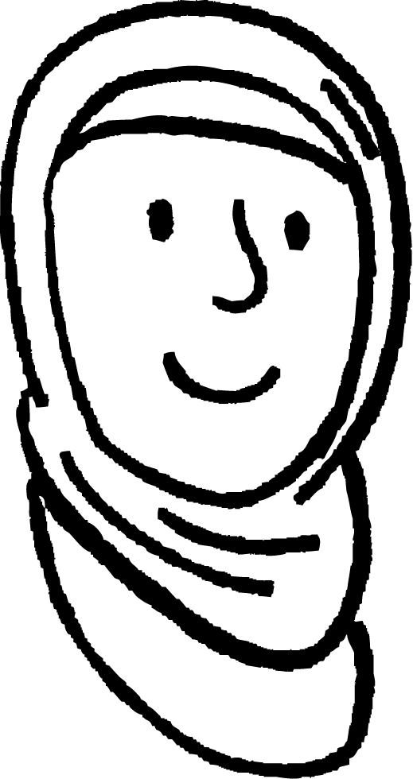
Understanding degrees of accuracy
Jun, Alex and Aisha are discussing the following statement.
In 2022 the attendance at Glastonbury Music Festival was 210 000.
The first digit is in the hundred thousands column, it must have been rounded to the nearest hundred thousand.
I don’t think the attendance has been rounded.
The last non-zero digit is in the ten thousands column. I think it has been rounded to the nearest ten thousand.
Jun
Alex
Who do you agree with?
Aisha is correct. It could also have been rounded to the nearest 1000, 100 or 10 and could be the exact value but that is very unlikely.
Aisha

Slide 7
Understanding degrees of accuracy
In 2022 the average cost of a house in the UK was £294 000.
What degree of accuracy is most likely to have been used here?
The last non-zero digit is in the thousands column. Therefore, it is most likely to have been rounded to the nearest thousand.

Slide 8
Understanding degrees of accuracy
In 2022 the average number of people in each household in the UK was 2.36
What degree of accuracy is most likely to have been used here?
It is most likely to have been rounded to 2 decimal places.

Slide 9
Understanding degrees of accuracy
In 2022 the average UK salary was £33 061
What degree of accuracy is most likely to have been used here?
It is most likely to have been rounded to the nearest integer (pound).

Slide 10
Understanding degrees of accuracy
In 2023 the world record for the men’s 100m sprint is 9.58 seconds.
What degree of accuracy is most likely to have been used here?
It is most likely to have been rounded to 2 decimal places
(1 hundredth of a second).

Slide 11
Understanding degrees of accuracy
The average speed of a plane is 550 mph.
What degree of accuracy is most likely to have been used here?
It is most likely to have been rounded to the nearest ten or fifty.

Slide 12

Understanding degrees of accuracy
Which of the following could be considered an appropriate degree of accuracy for the following?
The size of a town is 100 000.
nearest hundred thousand
nearest ten
1 significant figure
ten thousand

Slide 13
Understanding degrees of accuracy
1) Complete the table to show the most appropriate degree of accuracy:
 | Nearest integer | Nearest ten | Nearest hundred | Nearest thousand
The number of baked beans in a tin
The height at which a plane flies
Number of seats in 5 cinema screens
The number of people living in a street
Number of pages in a book
Number of buckets of water to fill a paddling pool
The number of grains of rice in 1 kg

Slide 14
Understanding degrees of accuracy
2) Complete the table to show which degree of accuracy is most likely to have been used:
 | 1 s.f. | 2 s.f. | 3 s.f. | 4 s.f.
The population of a town is 12 000
The length of a plank of wood is 6.24 m
The width of a blade of grass is 1.6 mm
The attendance at a pop concert is 30 000
62% of UK homes own a pet
The width of a human hair is 0.009 cm
The distance from Earth to the Moon is 384 400 km

Slide 15
Understanding degrees of accuracy
3) Rewrite the story below, rounding each of the numbers to an appropriate degree of accuracy.
Sofia belongs to a supporters club for her favourite football team. They decide to organise coaches to watch an away match. 19 coaches of 52 people set off for the match. The coach travels 262.504 km to the match which takes them 3 hours, 53 minutes and 15 seconds. Whilst at the match Sofia and her mum buy some lunch which costs £18.97. During the match there was an announcement that the attendance at the match is 51 699. The average speed of the coach on the way home is 54.89 mph. And they arrive home at 23:58:42.

Slide 16
Understanding degrees of accuracy
1) Complete the table to show the most appropriate degree of accuracy:
 | Nearest integer | Nearest ten | Nearest hundred | Nearest thousand
The number of baked beans in a tin
The height at which a plane flies
Number of seats in 5 cinema screens
The number of people living in a street
Number of pages in a book
Number of buckets of water to fill a paddling pool
The number of grains of rice in 1 kg

Slide 17
Understanding degrees of accuracy
2) Complete the table to show which degree of accuracy is most likely to have been used:
 | 1 s.f. | 2 s.f. | 3 s.f. | 4 s.f.
The population of a town is 12 000
The length of a plank of wood is 6.24 m
The width of a blade of grass is 1.6 mm
The attendance at a pop concert is 30 000
62% of UK homes own a pet
The width of a human hair is 0.009 cm
The distance from Earth to the Moon is 384 400 km

Slide 18
Understanding degrees of accuracy
3) Rewrite the story below, rounding each of the numbers to an appropriate degree of accuracy.
Sofia belongs to a supporters club for her favourite football team. They decide to organise coaches to watch an away match. 20 coaches of 50 people set off for the match. The coach travels 260 km to the match which takes them 4 hours. Whilst at the match Sofia and her mum buy some lunch which costs £20. During the match there was an announcement that the attendance at the match is 52 000. The average speed of the coach on the way home is 55 mph. And they arrive home at 12am.

Slide 19
Degrees of accuracy
Understanding degrees of accuracy
Answers to an appropriate degree of accuracy

Slide 20
Answers to an appropriate degree of accuracy
Calculate the area and perimeter of this shape.
Give your answer to an appropriate degree of accuracy.
What does it mean by an appropriate degree of accuracy?
8.4 cm
3.7 cm
If it was money, 2 decimal places would be appropriate.
Aisha
Jun

Slide 21
Answers to an appropriate degree of accuracy
Calculate the area and perimeter of this shape.
Give your answer to an appropriate degree of accuracy.
Yes, that’s right and if not, give it to the same degree of accuracy as the values in the question.
8.4 cm
3.7 cm
Here the dimensions are given to 1 decimal place, Therefore, we will give our answers to 1 decimal place.
Aisha
Jun

Slide 22
Answers to an appropriate degree of accuracy
Calculate the area and perimeter of this shape.
Give your answer to an appropriate degree of accuracy.
8.4 cm
Area = 8.4 × 3.7
= 31.08
= 31.1 cm² (to 1 d.p.)
Perimeter = 2(8.4 + 3.7)
= 2 × 12.1
= 24.2 cm
3.7 cm

Slide 23
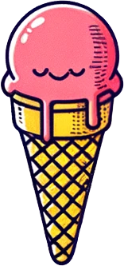
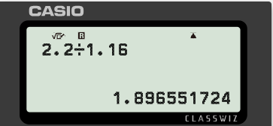
Answers to an appropriate degree of accuracy
The exchange rate of pounds to euros is £1 : €1.16
Convert the price of ice-cream into pounds.
Give your answer to an appropriate degree of accuracy.
£ | €
1 | 1.16
 | 2.20
£ | €
1 | 1.16
1.90 | 2.20
€2.20
× 1.16
÷ 1.16
Since we are talking about an amount of money, the appropriate degree of accuracy would be 2 decimal places.
The equivalent cost of the ice-cream in pounds is £1.90

Slide 24
Answers to an appropriate degree of accuracy
Andeep is helping his uncle work out how many boxes of grass seed are needed to cover this piece of his garden.
1 box of grass seed covers approximately 10 m² and costs £7.
How many boxes do they need?
Firstly we need to calculate the area of the garden.
2.4 m
2.4 m
4.8 m

Slide 25
Answers to an appropriate degree of accuracy
Find missing dimensions
2.4 m
Complete the square
Area = 4.8 × 4.8 − 2.4 × 2.4
= 23.04 − 5.76
= 17.28 m²
4.8 m ÷ 2
2.4 m
2.4 m
Although this is to a greater degree of accuracy than the values in the question, we would not round at this point. Rounding should only take place when giving the final answer.
4.8 m
2.4 m
2.4 m + 2.4 m
4.8 m

Slide 26
Answers to an appropriate degree of accuracy
1 box of grass seed covers approximately 10 m² and costs £7.
How many boxes do they need?
Area of the garden = 17.28 m²
2.4 m
2.4 m
4.8 m
Number of boxes = 17.28 ÷ 10
= 1.728
= 2
Cost = 2 × 7
= £14

Slide 27
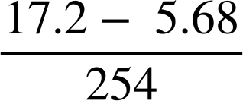
Answers to an appropriate degree of accuracy
Calculate the following giving your answer to an appropriate degree of accuracy.
Firstly, we will decide on an appropriate degree of accuracy.
What do you think an appropriate degree of accuracy is here?
They do not have the same number of decimal places. But, they do each have 3 significant figures. Therefore, we will give our answer to 3 significant figures.

Slide 28
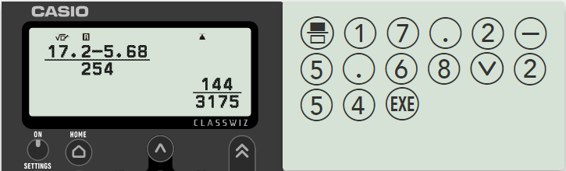
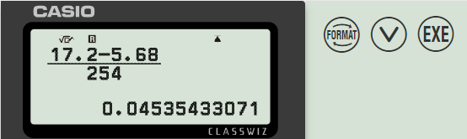
Answers to an appropriate degree of accuracy
Calculate the following giving your answer to an appropriate degree of accuracy.
0.04535… = 0.0454 (to 3 s.f.)

Slide 29
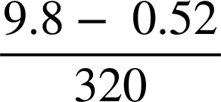
Answers to an appropriate degree of accuracy
Match each problem to the most appropriate degree of accuracy:
Converting $ into £
1 s.f.
The area of a square with sides 5.6 cm
2 s.f.
The number of boxes needed for 95 eggs
1 d.p.
2 d.p.

Slide 30
Answers to an appropriate degree of accuracy
In each of the following questions give your answers to an appropriate degree of accuracy.
Calculate the area and perimeter of the following:
a)
b)
5.2 cm
4.9 cm
3.4 cm
1.28 m
3.65 m

Slide 31
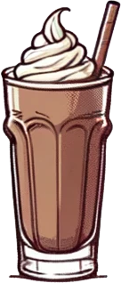
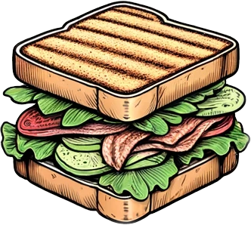
Answers to an appropriate degree of accuracy
In each of the following questions give your answers to an appropriate degree of accuracy.
2) Convert the following from dollars into pounds:
Using the exchange rate £1 : $1.27
a)
b)
$2.95
$2.95
$5.70

Slide 32
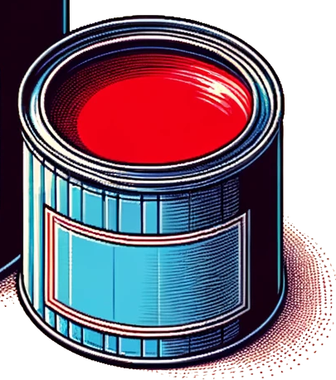
Answers to an appropriate degree of accuracy
3) Answer the following. At each stage give your answer to an appropriate degree of accuracy.
How much will it cost to paint this wall?
1 tin of paint covers 25 m².
£19.50
2.5 L
4 m
6.84 m
5.35 m
8.25 m

Slide 33
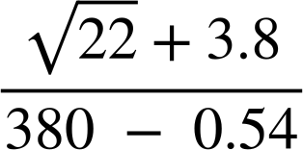
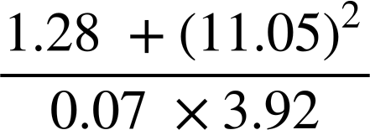
Answers to an appropriate degree of accuracy
In each of the following questions give your answers to an appropriate degree of accuracy.
4) Use you calculator to answer the following:
a)
b)

Slide 34
Answers to an appropriate degree of accuracy
In each of the following questions give your answers to an appropriate degree of accuracy.
Calculate the area and perimeter of the following:
a)
b)
Perimeter = 2 × 5.2 + 3.4
= 13.8 cm
Area = ½ × 3.4 × 4.9
= 8.3 cm² (to 1 d.p.)
5.2 cm
4.9 cm
3.4 cm
Perimeter = 2 × (1.28 + 3.65)
= 9.86 m
Area = 1.28 × 3.65
= 4.67 m² (to 2 d.p.)
1.28 m
3.65 m

Slide 35
Answers to an appropriate degree of accuracy
In each of the following questions give your answers to an appropriate degree of accuracy.
2) Convert the following from dollars into pounds:
Using the exchange rate £1 : $1.27
a)
b)
£ | $
1 | 1.27
2.32 | 2.95
× 1.27
$2.95
$2.95
÷ 1.27
£ | $
1 | 1.27
4.49 | 5.70
$5.70
× 1.27
÷ 1.27

Slide 36
Answers to an appropriate degree of accuracy
3) Answer the following. At each stage give your answer to an appropriate degree of accuracy.
How much will it cost to paint this wall?
1 tin of paint covers 25 m².
£19.50
2.5 L
Area of wall = 50.47 m²
Number of tins of paint = 50.47 ÷ 25
= 2.018…
= 3
Cost of paint = 3 × 19.50
= £58.50
4 m
6.84 m
5.35 m
8.25 m

Slide 37
Answers to an appropriate degree of accuracy
In each of the following questions give your answers to an appropriate degree of accuracy.
4) Use you calculator to answer the following:
a)
b)
0.022 (to 2 s.f.)
449.64 (to 2 d.p.)

Slide 38
Degrees of accuracy
Degrees of accuracy show how precise a number or measurement is.
If the degree of accuracy is not stated you can make a conjecture about what you think it is.
When working with money, answers should be given to 2 decimal places.
If the degree of accuracy required is not stated in a question, you should give your answer to the degree of accuracy of the values in the question.

Slide 39

© Oak National Academy 2024.
Produced in partnership with Mathematics in Education and Industry.
Licensed on the Open Government Licence v3.0, except where otherwise stated. See Oak terms and conditions.

